Slide 1
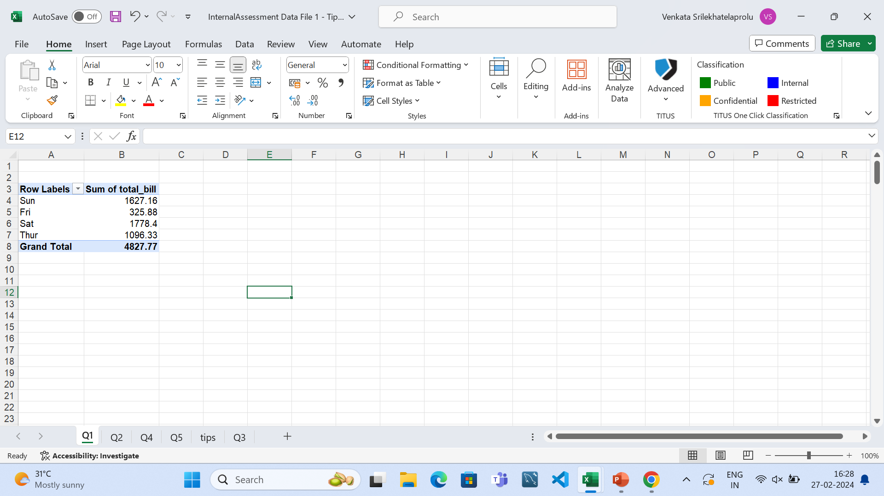
Q1

Slide 2
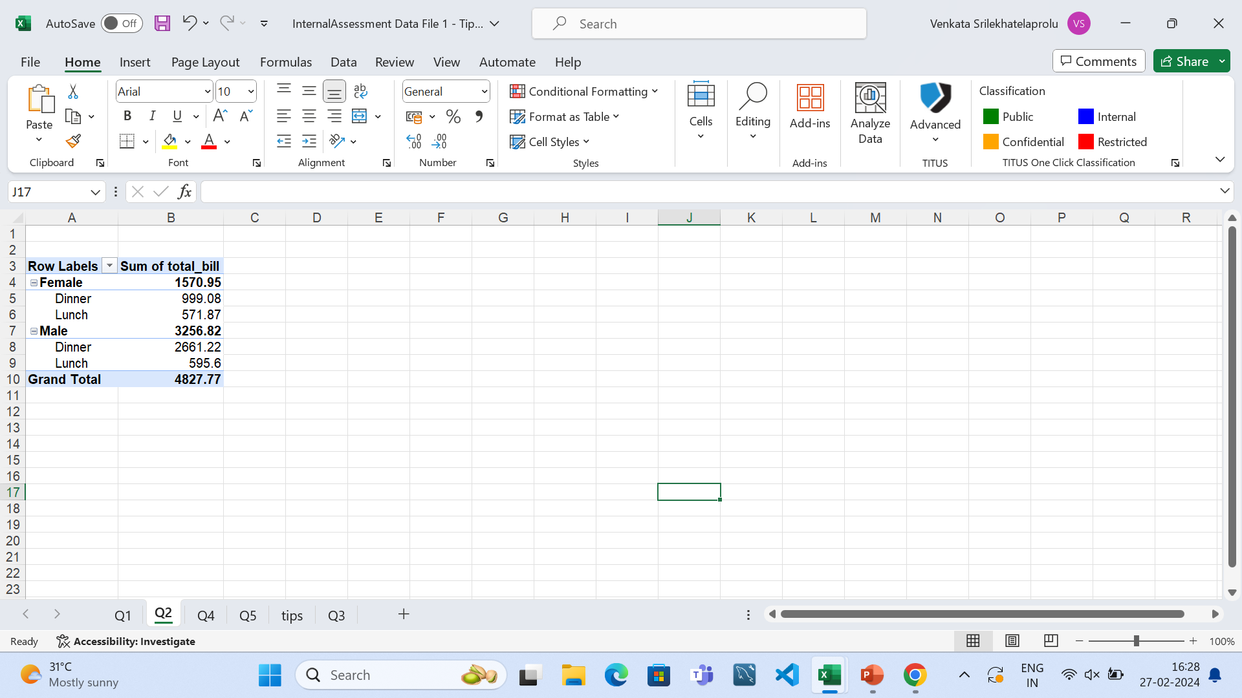
Q2

Slide 3
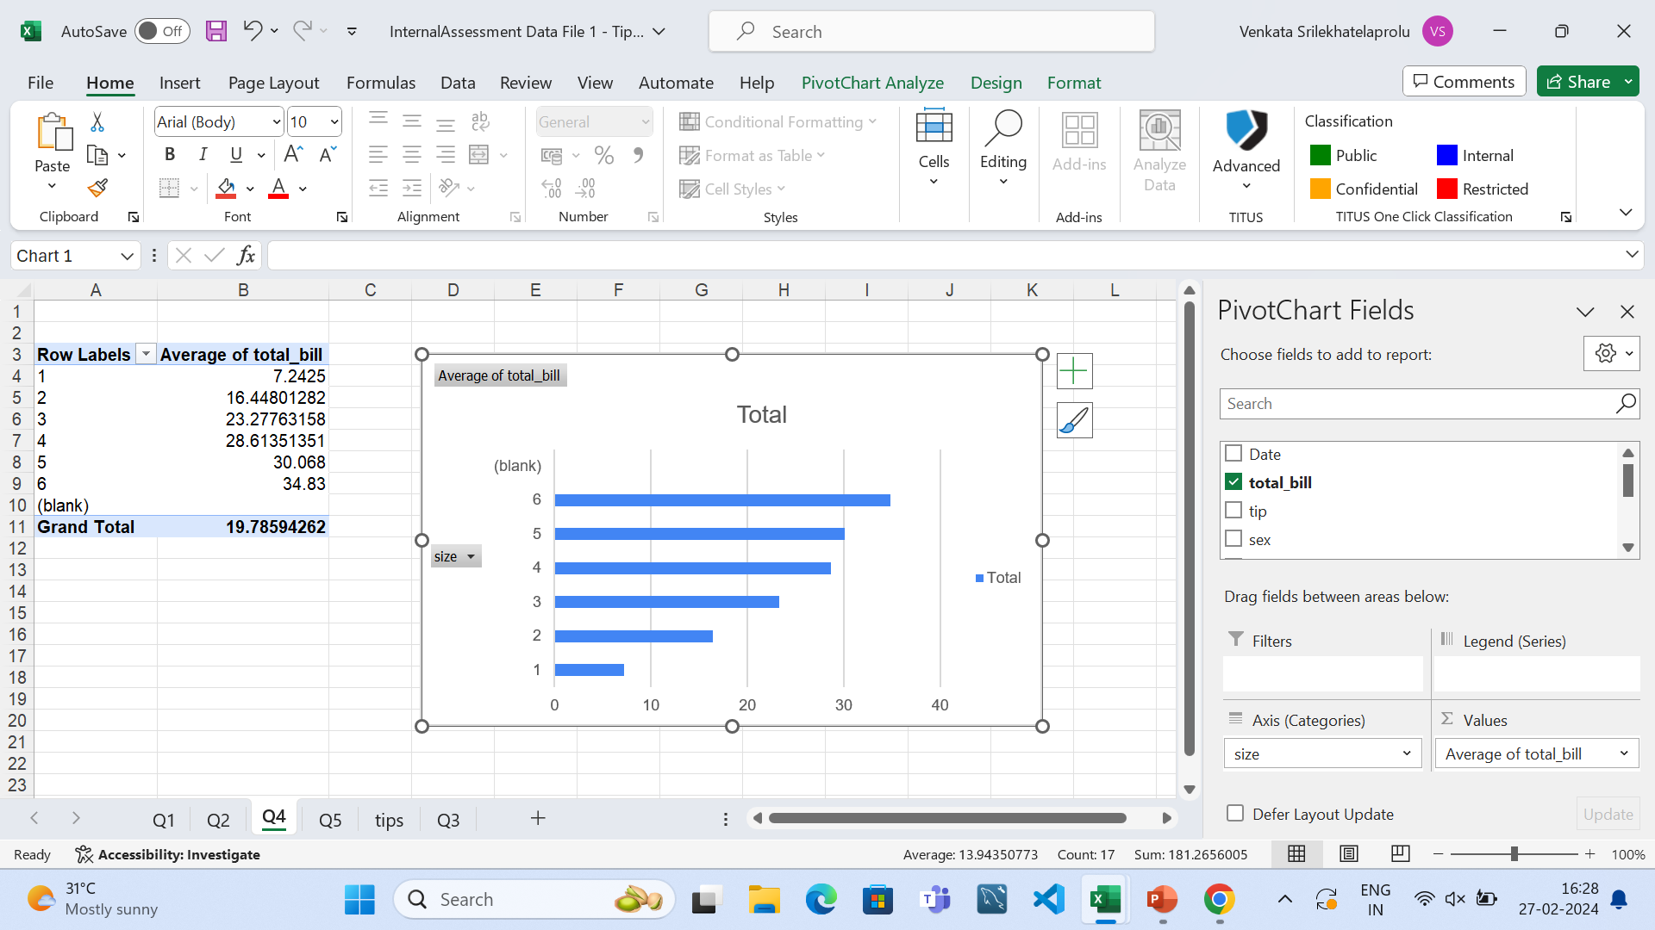
Q4

Slide 4
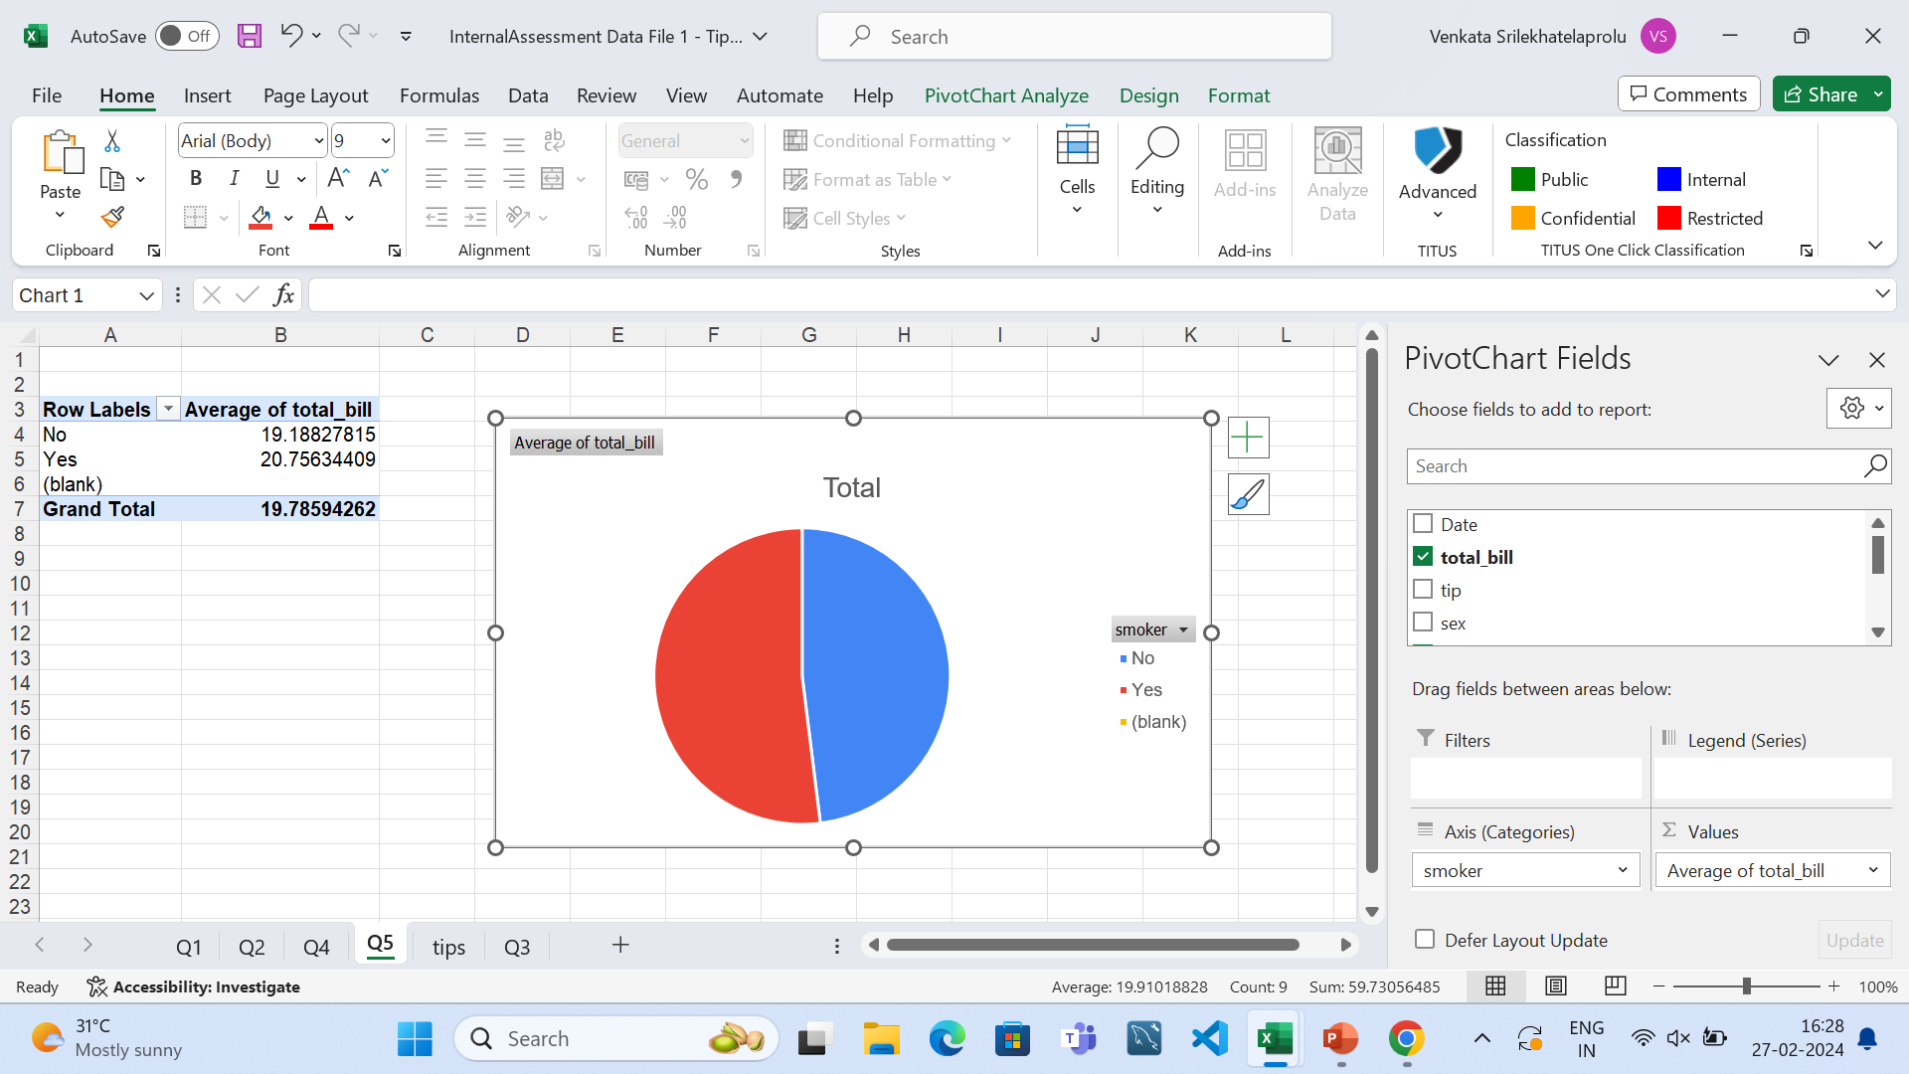
Q5
Hence,from pie chart we can infer that the total bill for the non-smokers is slight less with that of the smokers

Slide 5
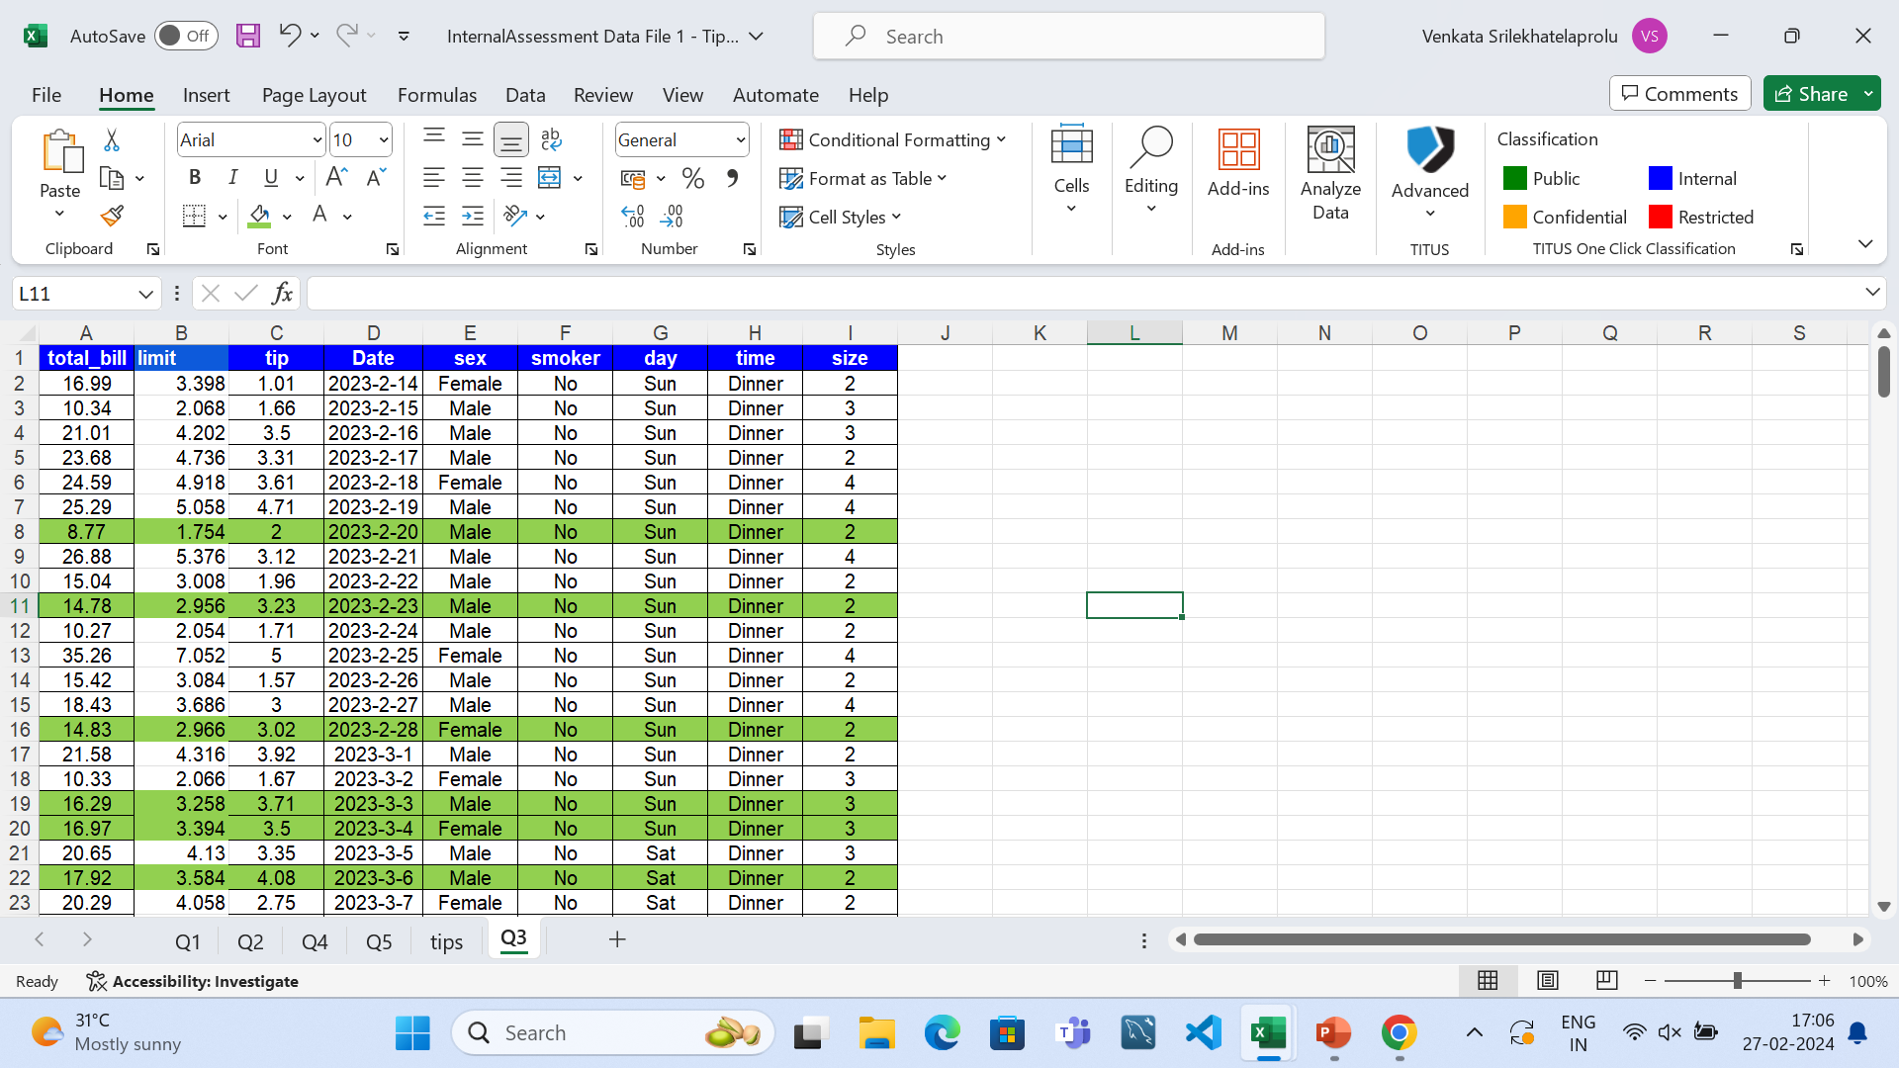
Q3

Slide 6
